Slide 1
A KOOS Calculator for Detecting Osteoarthritis Level
Supervised by-
Dr. Mahmuda Naznin
Professor
CSE, BUET
(A part of collaborative research with
Dr. Ahmed Suparna Bahar Moni, University of Science, Malaysia &
Dr. Tanvir Rahman Faisal, University of Louisiana, USA)
Presented by -
Mursheda Tasnim
ID : 1605095

Slide 2
Outline
Introduction
Background
Problem Domain
Method
Results
Conclusion
Future work
References

Slide 3
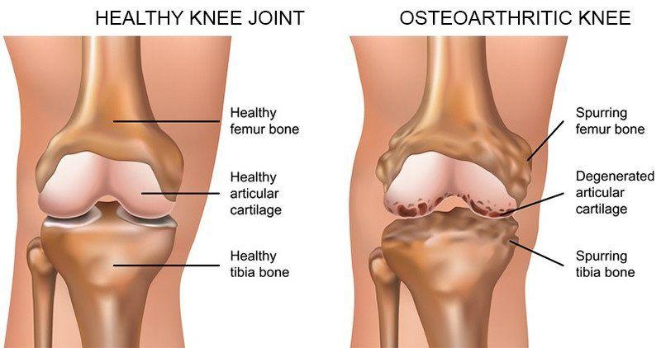
Introduction : Osteoarthritis

Slide 4
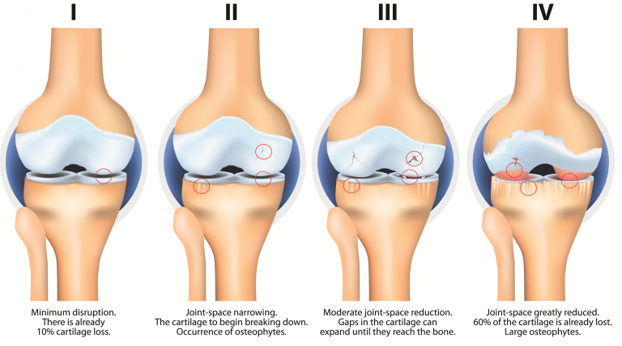
Introduction : Stages of Osteoarthritis

Slide 5
Introduction : KOOS
A self-reported outcome measure assessing the patient's opinion about the health, symptoms, and functionality of their knee
A 42-item questionnaire, including 5 subscales: symptoms, pain, ADLs, sports/recreation, and quality of life
The maximum score a patient can achieve is 100, indicating no knee problems
The minimum score is zero, indicating severe knee problems

Slide 6
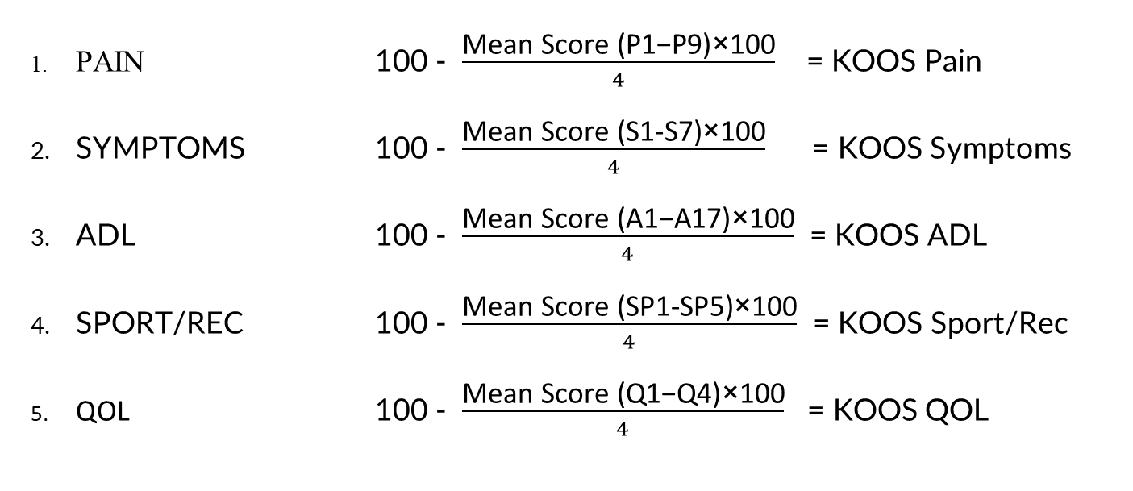
Introduction : KOOS Calculation
PAIN 100 - $\frac{\text{Mean} \text{Score}\text{ (}\text{P}\text{1−}\text{P}\text{9)}\text{×}\text{100}}{4}$ = KOOS Pain
SYMPTOMS 100 - $\frac{\text{Mean} \text{Score}\text{ (}\text{S}\text{1-}\text{S}\text{7)}\text{×}\text{100}}{4}$ = KOOS Symptoms
ADL 100 - $\frac{\text{Mean} \text{Score}\text{ (}\text{A}\text{1−}\text{A}\text{17)}\text{×}\text{100}}{4}$ = KOOS ADL
SPORT/REC 100 - $\frac{\text{Mean} \text{Score}\text{ (}\text{SP}\text{1-}\text{SP}\text{5)}\text{×}\text{100}}{4}$ = KOOS Sport/Rec
QOL 100 - $\frac{\text{Mean} \text{Score}\text{ (}\text{Q}\text{1−}\text{Q}\text{4)}\text{×}\text{100}}{4}$ = KOOS QOL

Slide 7
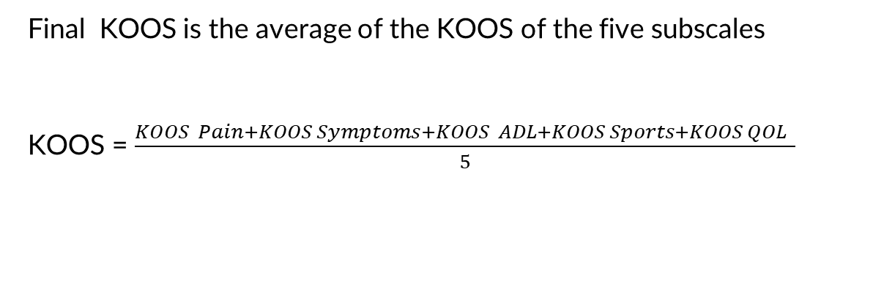
Introduction : KOOS Calculation
Final KOOS is the average of the KOOS of the five subscales
KOOS = $\frac{KOOS Pain+KOOS Symptoms+KOOS ADL+KOOS Sports+KOOS QOL }{5}$

Slide 8



Background : Current Practice of OA Evaluation
Manually clinical and sociodemographic data collection
Third Party software for KOOS calculation
No well-organized database
for storing data

Slide 9


Background : Our Goals
Ease of both patients and doctors
Efficiency

Slide 10
Problem Domain
KOOS Calculator
Patient Profile
Clinical Information Collection
OA APP
Well-formed Database to store data
Socio-demographic Information Collection

Slide 11
Problem Domain : User Profile
Mobile Number
PID (At present based on Malaysian Health Record System, can be customized for any country)

Slide 12
Problem Domain : KOOS Calculator
Pain
Symptoms
ADLs
Sports and recreation function
Quality of life

Slide 13
Problem Domain : Clinical Information Collection
Height
Weight
Waist circumference
Which knee is affected?
What are the symptoms of the affected knee?
Do you have pain in other joints?
Menstrual history (for female)
Smoking
Alcohol intake
Sports activity
Recent injury to knee

Slide 14
Problem Domain : Socio-demographic Information Collection
Occupation
Activity associated with work
House type
Floor number
Frequent use of staircase
House toilet type
Prayer position

Slide 15


Problem Domain : Well-formed database
User authentication
Storing other information

Slide 16



Method : OA APP

Slide 17
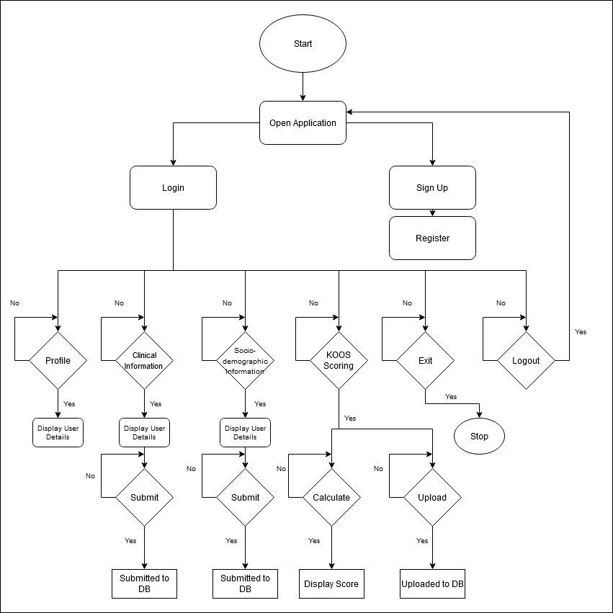
Flow Chart

Slide 18
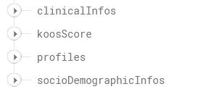


Method : Database Management
For user profile authentication
For storing other information

Slide 19
Results
Test Environment
App tested in android devices
Data is displayed in a web page
No pilot study is performed

Slide 20
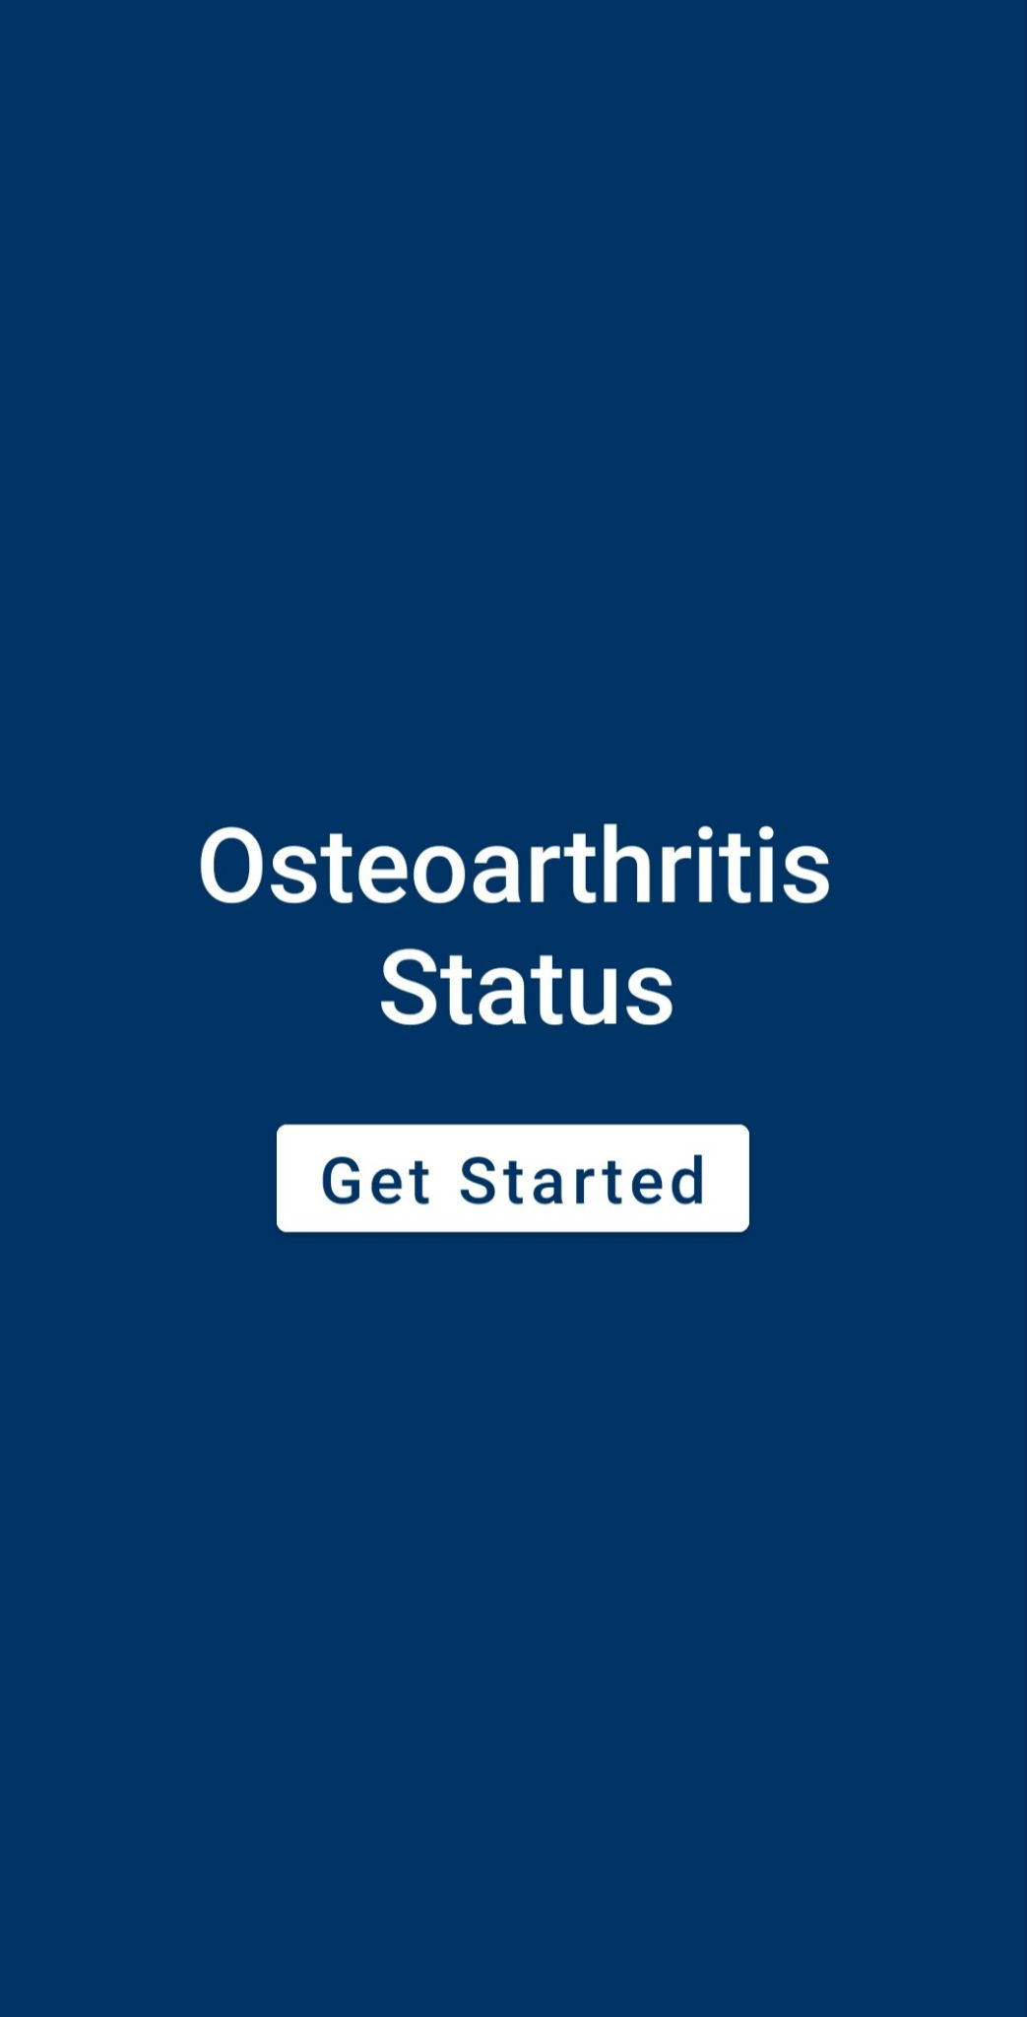
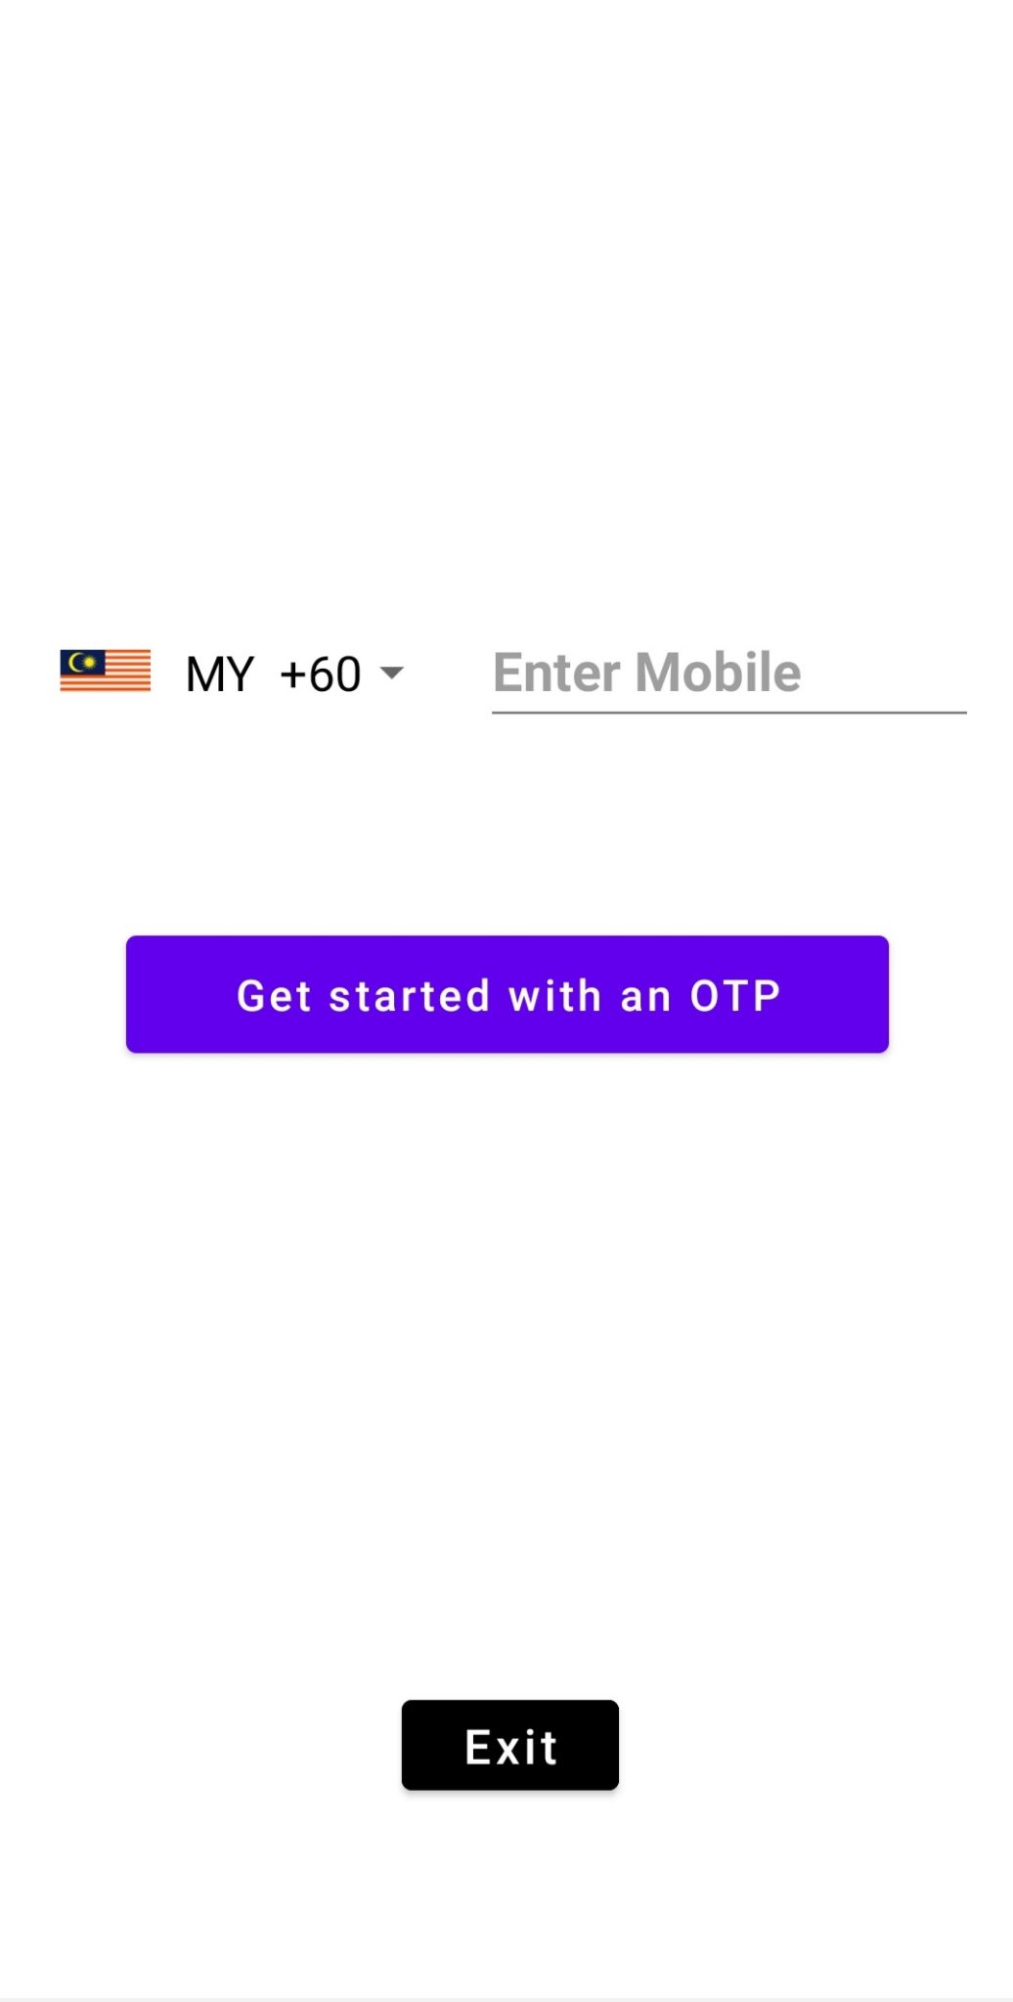
Results

Slide 21
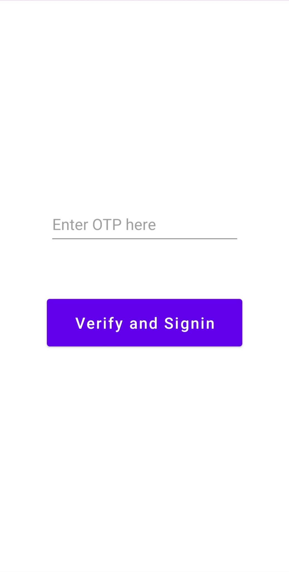
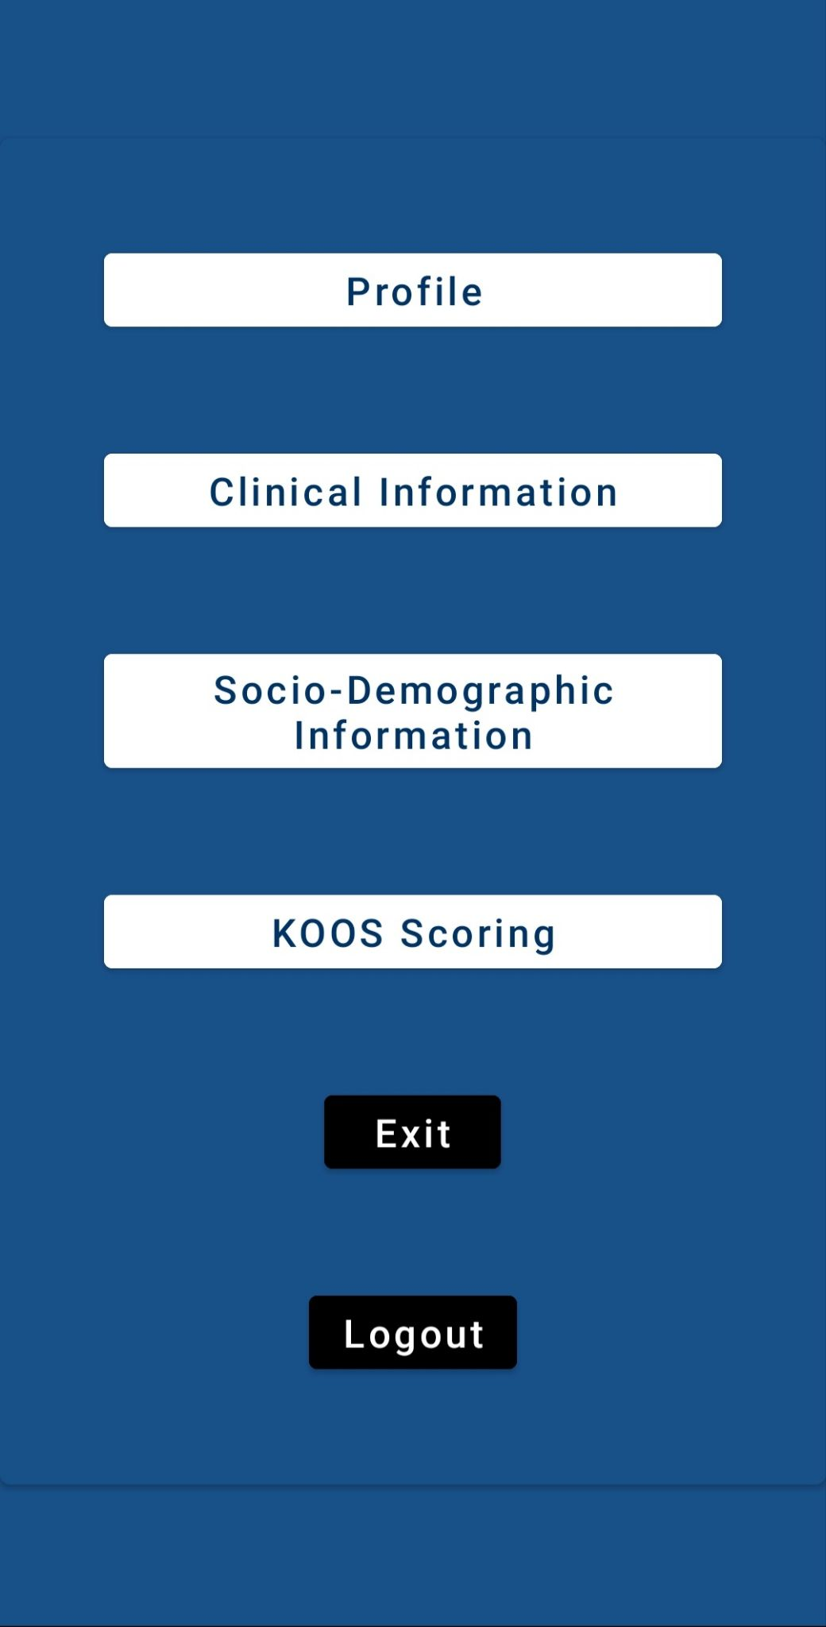
Results

Slide 22

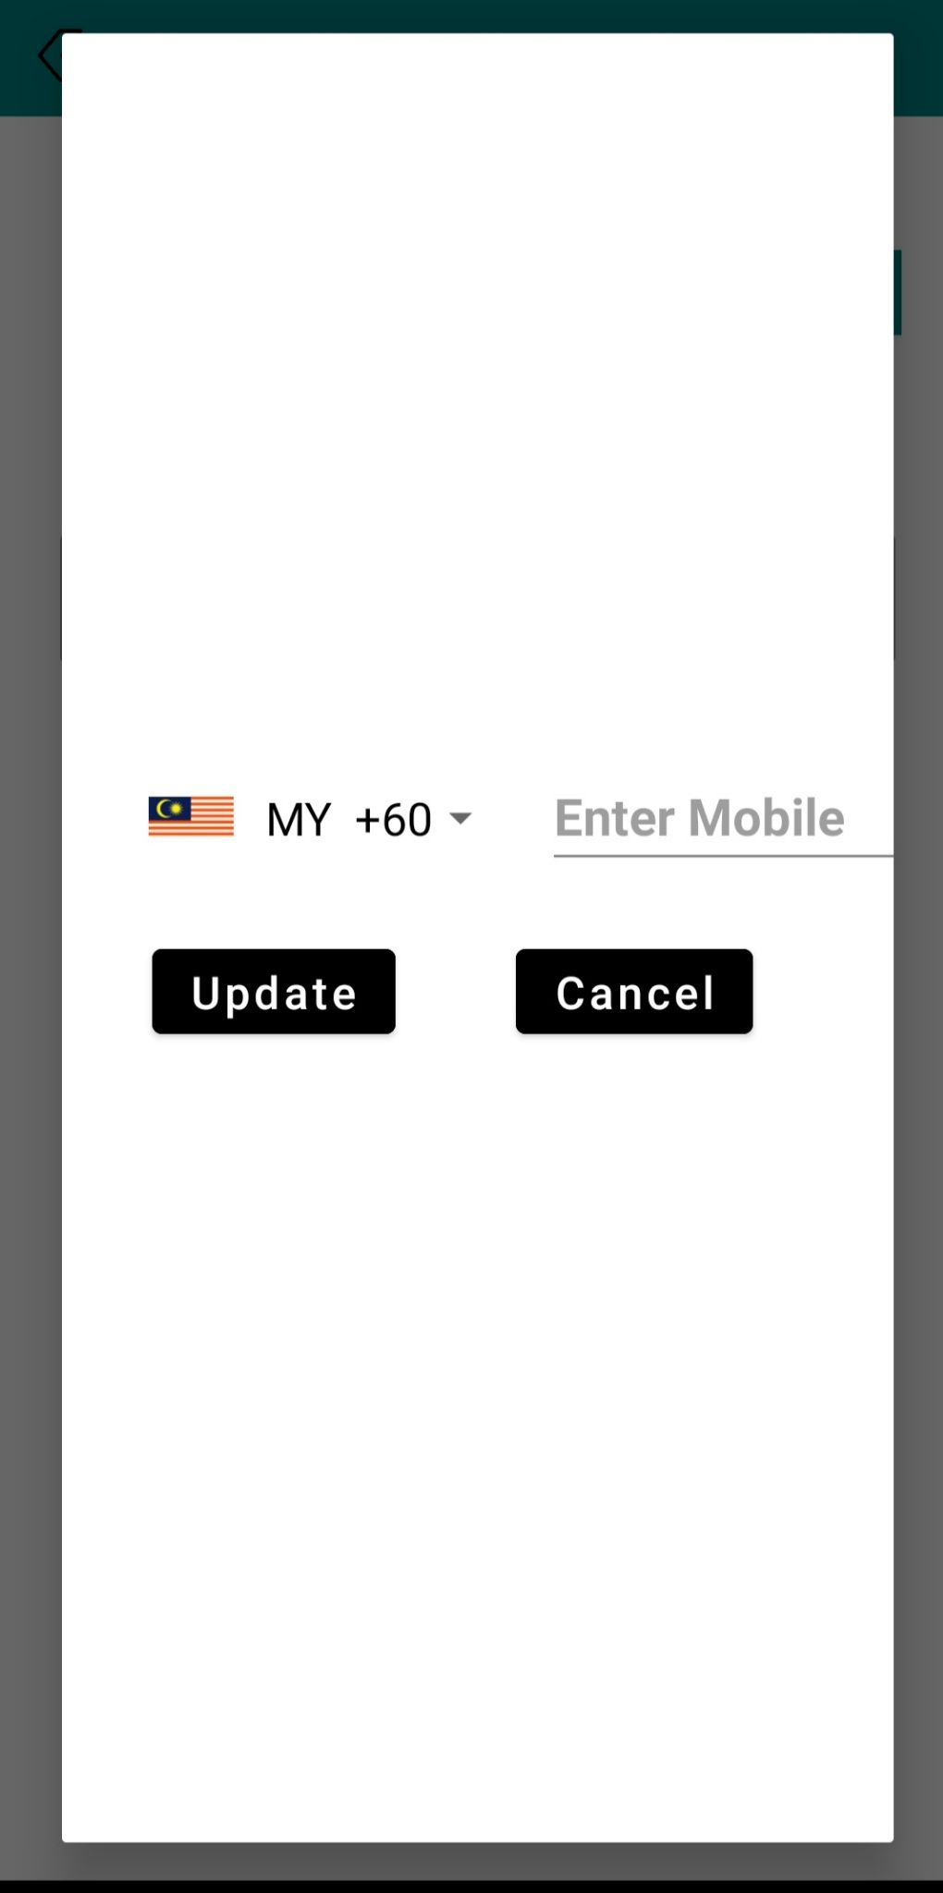
Results

Slide 23
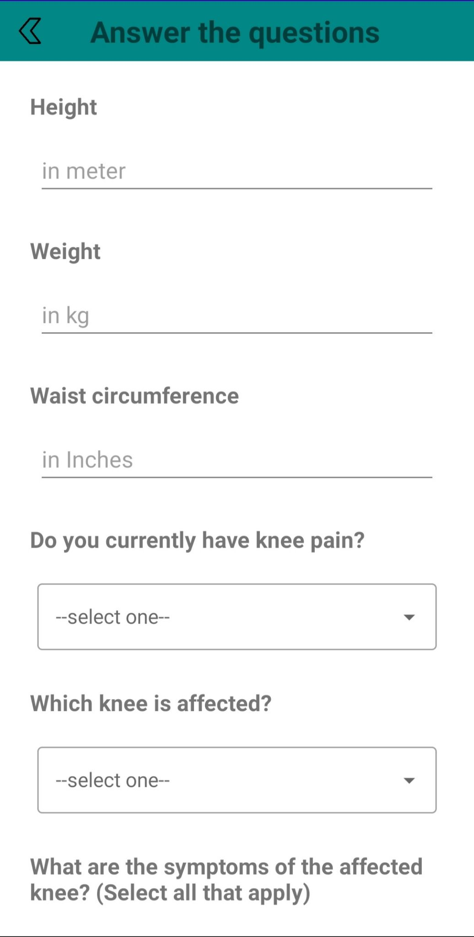
Results

Slide 24
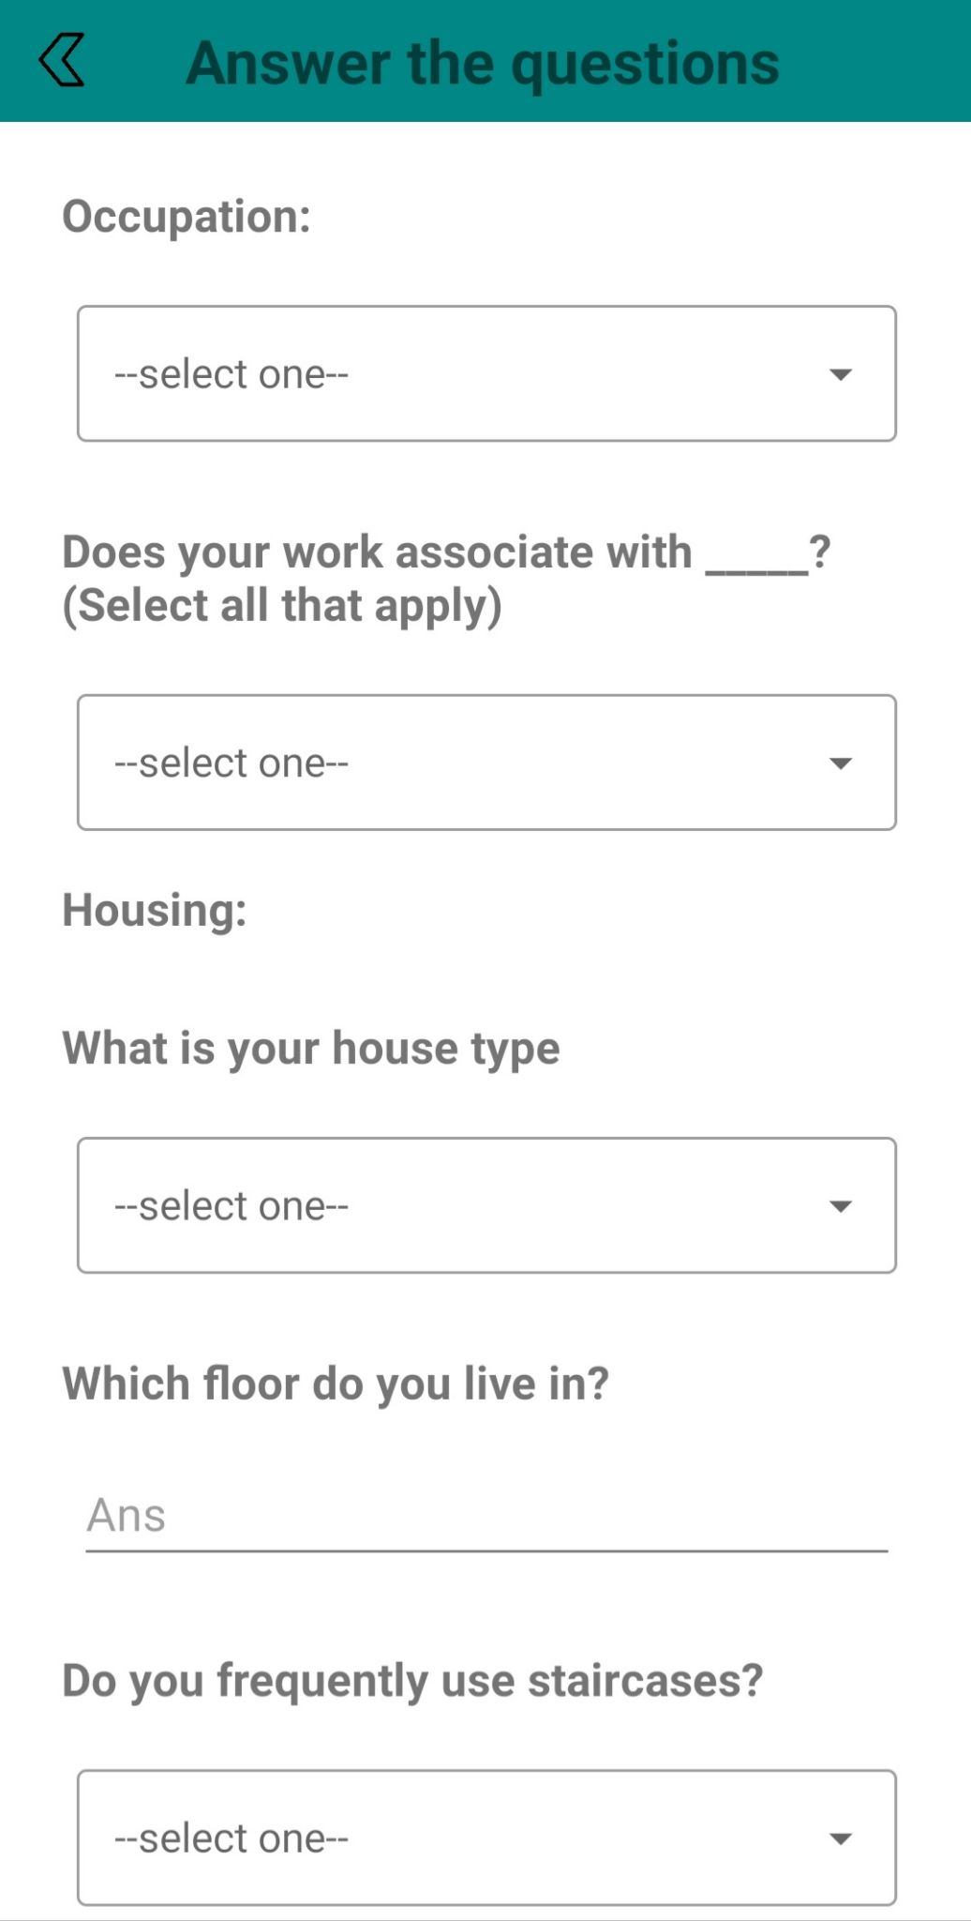
Results

Slide 25
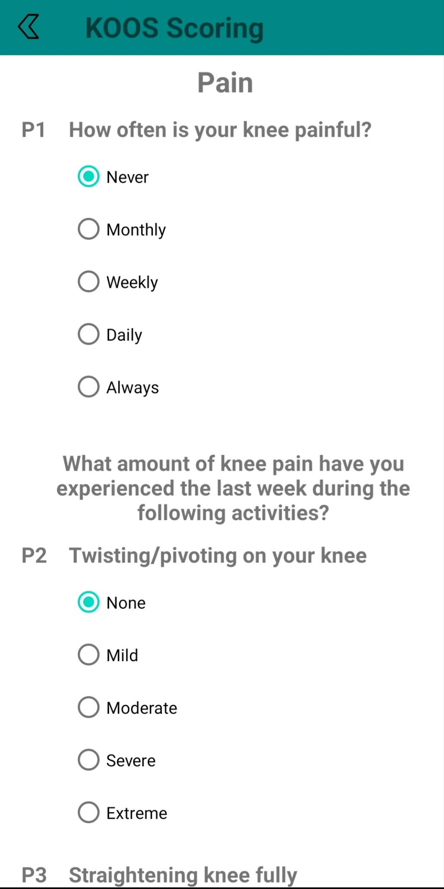
Results

Slide 26
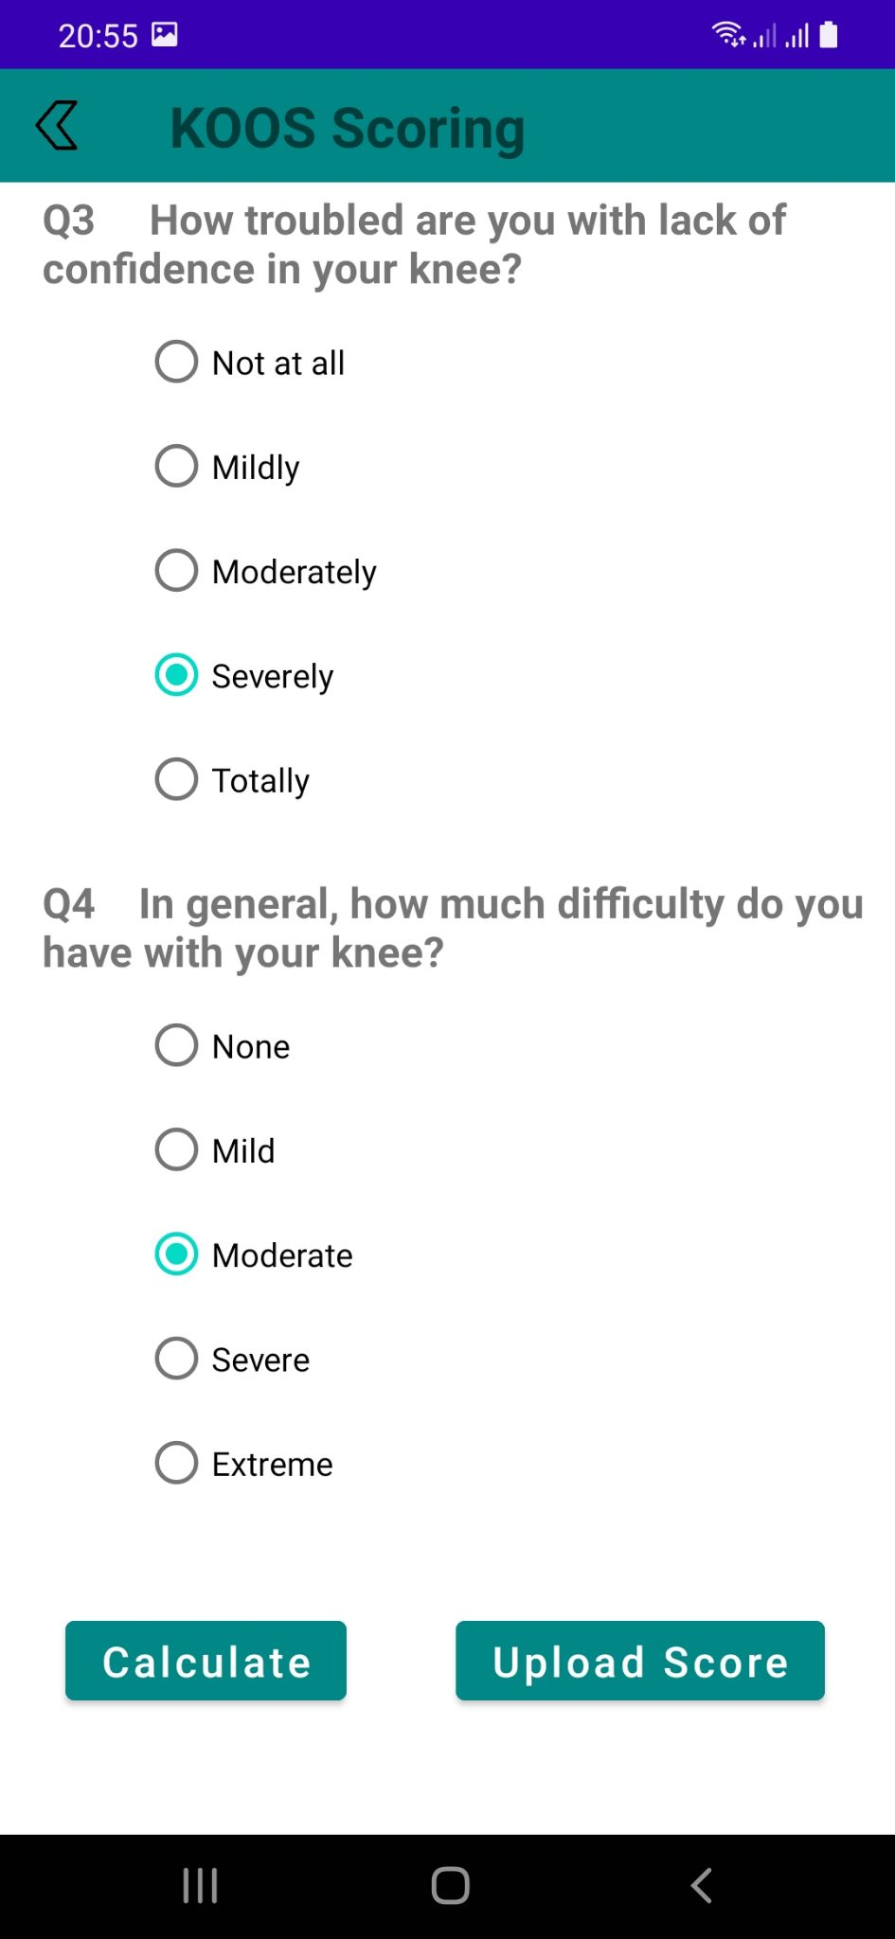
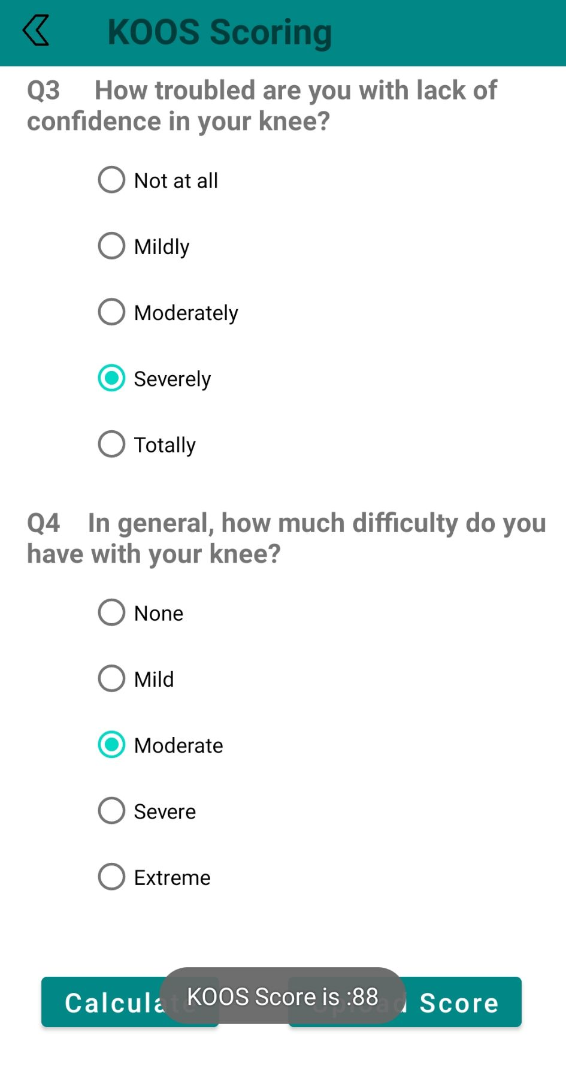
Results

Slide 27
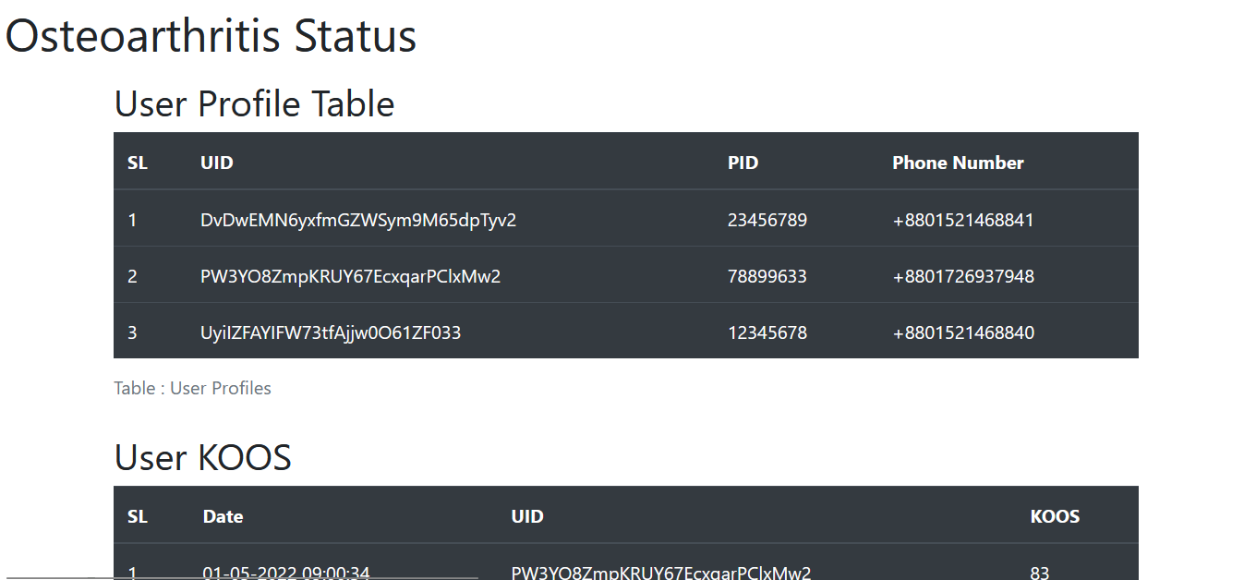
Results : Doctor’s Side View of Collected Data
Site Link : https://murshedatasnim.github.io/OA-App-Doctors-Side/

Slide 28



Conclusion
Beneficial
Easy to use
User friendly

Slide 29
Future Work
The database will be deployed in AWS
The App will be available in Google Play Store
The data collected from this application will be used to train a machine learning model to predict future OA level of a patient

Slide 30
References
https://orthoinfo.aaos.org/en/diseases--conditions/arthritis-of-the-knee/
https://developer.android.com/docs
https://www.mayoclinic.org/diseases-conditions/osteoarthritis/symptoms-causes/syc-20351925
http://www.koos.nu/KOOSscoring2012.pdf
https://www.apta.org/patient-care/evidence-based-practice-resources/test-measures/knee-injury-and-osteoarthritis-outcome-score-koos
https://firebase.google.com/docs?gclid=CjwKCAjw9-KTBhBcEiwAr19igxdzkOss8fAQFgY0g1x9r_aSb3GJh0hmz1-j6OVn6h67mbCuU5JIihoCt5kQAvD_BwE&gclsrc=aw.ds
https://teachmesurgery.com/orthopaedic/principles/osteoarthritis/

Slide 31
Thank you

